Slide 1
An Introduction to VHDL languages
Dr. Hakem Beitollahi
Computer Engineering Department
Elmo Sanat University
Notes:
The University of Adelaide, School of Computer Science
Chapter 2 — Instructions: Language of the Computer

Slide 2
Outline
Types of HDL
VHDL versus Verilog
VHDL (introduction)
HDL— <number>

Slide 3
hardware description language
A hardware description language (HDL) is a specialized computer language used to describe the structure and behavior of digital systems
A hardware description language looks much like a programming language such as C.
The main difference with software programming languages is the nature of HDL is parallel; while the nature of software languages is sequential
It is a textual description consisting of expressions, statements and control structures
Most commercial designs built using HDLs
HDL — <number>

Slide 4
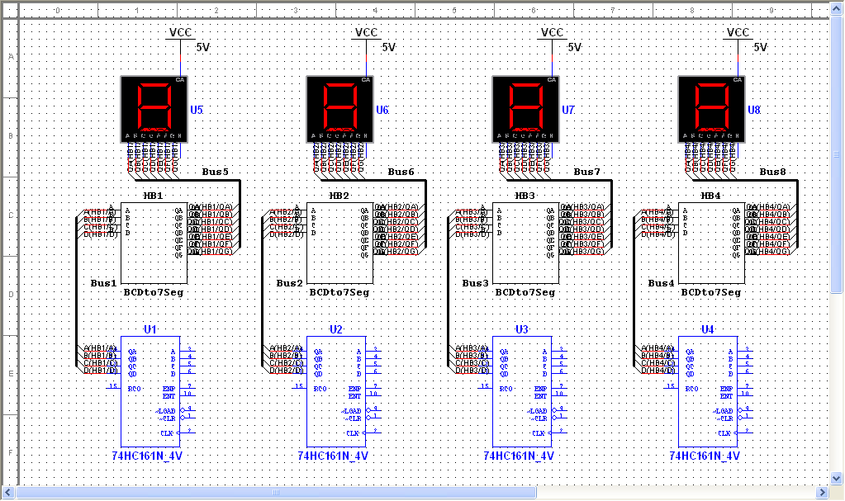
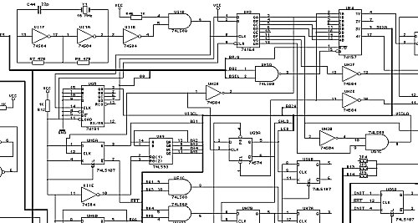
HDL vs. Schematic
Schematic’s advantages
  Useful for small projects
  Easy to learn and design
Schematic’s disadvantages
  difficult to manage when complexity grows (million gates ASICs-FPGAs)
  difficult to maintain for a long lifetime
HDL — <number>

Slide 5
Types of HDL languages
Two leading HDLs:
  Verilog
    developed in 1984 by Gateway Design Automation
    became an IEEE standard (1364) in 1995
  VHDL
    Developed in 1981 by the Department of Defense
    Became an IEEE standard (1076) in 1987
Other HDL languages
  GEZEL
  SystemC (enhance C for hardware design)
  System Verilog (Add system level design to Verilog)
  Ruby
  JHDL
  Etc.
HDL — <number>

Slide 6
VHDL vs. Verilog
Verilog is based on C, while VHDL is based on Pascal and Ada.
Unlike Verilog, VHDL is strongly typed.
Unlike VHDL, Verilog is case sensitive.
Verilog is easier to learn compared to VHDL.
Verilog has very simple data types, while VHDL allows users to create more complex data types
Verilog will not allow programmers to put needed modules in separate files that are called during compilation. Large projects on Verilog might end up in a large, and difficult to trace, file.
VHDL more popular with European companies, Verilog more popular with US companies
HDL — <number>
Notes:
The University of Adelaide, School of Computer Science
Chapter 2 — Instructions: Language of the Computer

Slide 7
VHDL vs. Verilog
High level constructs
  VHDL:
    There are more constructs and features for high-level modeling in VHDL than there are in Verilog.
    Abstract data types can be used along with the following statements:
      package statements for model reuse,
      configuration statements for configuring design structure,
      generate statements for replicating structure,
      generic statements for generic models that can be individually characterized, for example, bit width.
  Verilog:
    there is no equivalent to the high-level VHDL modeling statements in Verilog
HDL — <number>

Slide 8
VHDL vs. Verilog
Libraries
  VHDL:
    A library is a store for compiled entities, architectures, packages and configurations. Useful for managing multiple design projects.
  Verilog:
    There is no concept of a library in Verilog. This is due to it's origins as an interpretive language.
HDL — <number>

Slide 9
VHDL vs. Verilog
Low level constructs
  VHDL
    Simple two input logical operators are built into the language, they are: NOT, AND, OR, NAND, NOR, XOR and XNOR.
    Any timing must be separately specified using the after clause.
  Verilog
    The Verilog language was originally developed with gate level modeling in mind, and so has very good
    constructs for modeling at this level and for modeling the cell primitives of ASIC and FPGA libraries.
    Examples include User Defined Primitives (UDP), truth tables and the specify block for specifying timing delays across a module.
HDL — <number>

Slide 10
VHDL vs. Verilog
Example [Binary up counter]
VHDL
process (clock)
begin
if clock='1' and clock'event then
counter <= counter + 1;
end if;
end process;
Verilog
reg [upper:0] counter;
always @(posedge clock)
counter <= counter + 1;
HDL — <number>

Slide 11
VHDL vs. Verilog
Verilog and VHDL are equivalent for RTL modeling (code that will be synthesized).
For high level behavioral modeling, VHDL is better
  Verilog does not have ability to define new data types
  Other missing features for high level modeling
Verilog has built-in gate level and transistor level primitives
  Verilog much better than VHDL at below the RTL level.
The choice of which to use is not therefore based solely on technical capability but on:
  Personal preferences
  EDA (Electronic design automation) tool availability
  Commercial, business and marketing issues
Bottom Line: You should know both!!!!!
HDL — <number>

Slide 12
VHDL
HDL — <number>

Slide 13
Introduction to VHDL
VHDL: VHSIC Hardware Description Language
  VHSIC: Very High Speed Integrated Circuit
History of VHDL
  1980: initiated by US army (Pentagon) to describe and to document of electronic systems
  1985: 7.2 version of VHDL by IBM, Intermetrics and Texas Instruments
  1986: All rights transfer to IEEE
  1987: first IEEE version – IEEE1067-1987
  1993: Revised Standard- IEEE1076-1993 (vhdl-93)
  2000: minor revision
  2002: minor revision
  2008: major revision
  2019: major revision (latest version of VHDL)

Slide 14
Introduction to VHDL
How is VHDL used?
  For design specification
  For simulation
  For documentation
  For implementation
  For test & verification
  As an alternative to schematic design
Why VHDL?
  Achieve Maximum Reliability With
    Minimum cost
    Minimum development time
  Allow Automatic Synthesis of Design into Hardware

Slide 15
Introduction to VHDL
C:
  Procedural (method) programming languages
  Typically describe methods for computing a math function or manipulation of data (e.g., sorting, matrix computing)
  A program is a recipe or a sequence of steps for how to perform a computation or manipulate data.
VHDL:
  A language to describe digital systems.
  Purposes: simulation and synthesis of digital systems.

Slide 16
Design Process
HDL — <number>

Slide 17
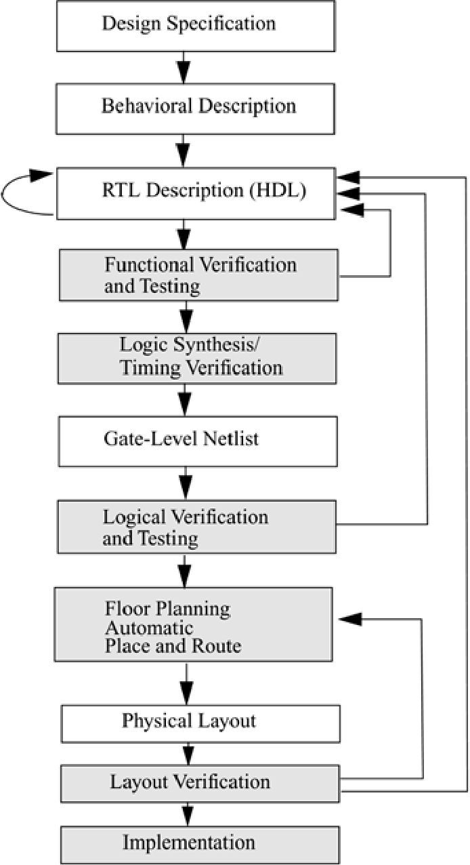
Digital System Design Process
HDL — <number>

Slide 18
Different perspectives of a system
Behavioral view:
  Describe functionalities and i/o behavior
  Treat the system as a black box
  Use flowcharts, Pseudocode, flow graph
Structural view:
  Describe the internal implementation (components and interconnections)
  Essentially block diagram
  Registers, logic components are connected via buses (directional or bi-directional)
Physical view:
  Add more info to structural view: component size, component locations, routing wires
  E.g., layout of a print circuit board

Slide 19
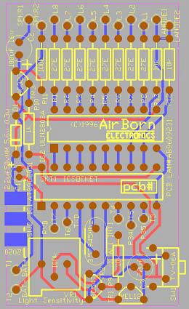
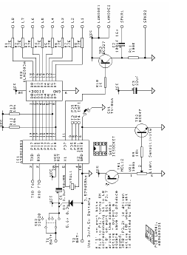
Structural view vs. physical view
HDL — <number>

Slide 20
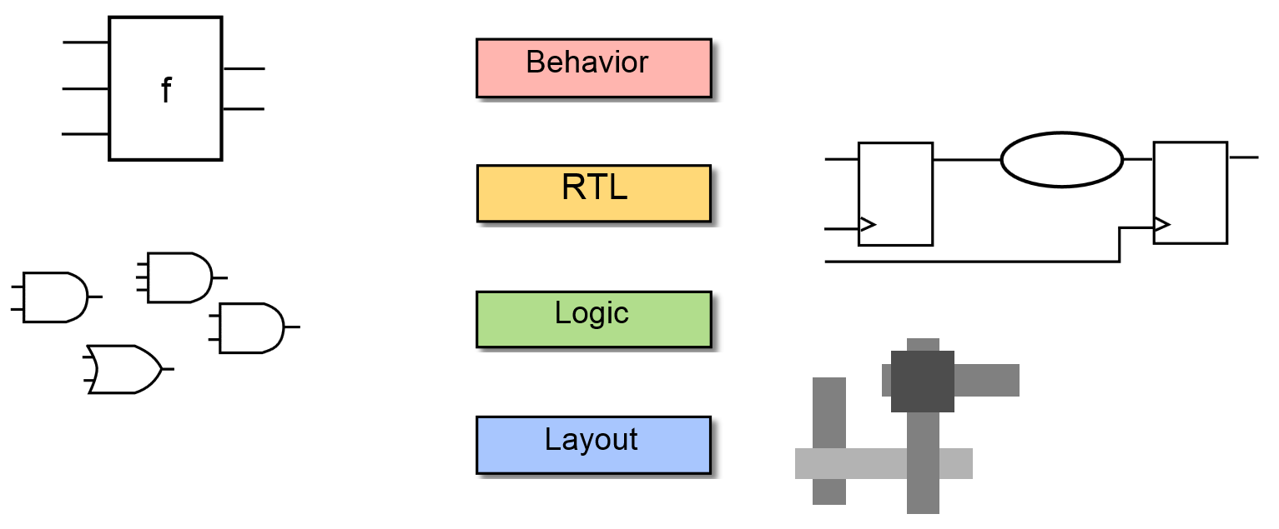
VHDL: Abstraction Levels (I)
Abstraction levels of System Design
HDL — <number>

Slide 21
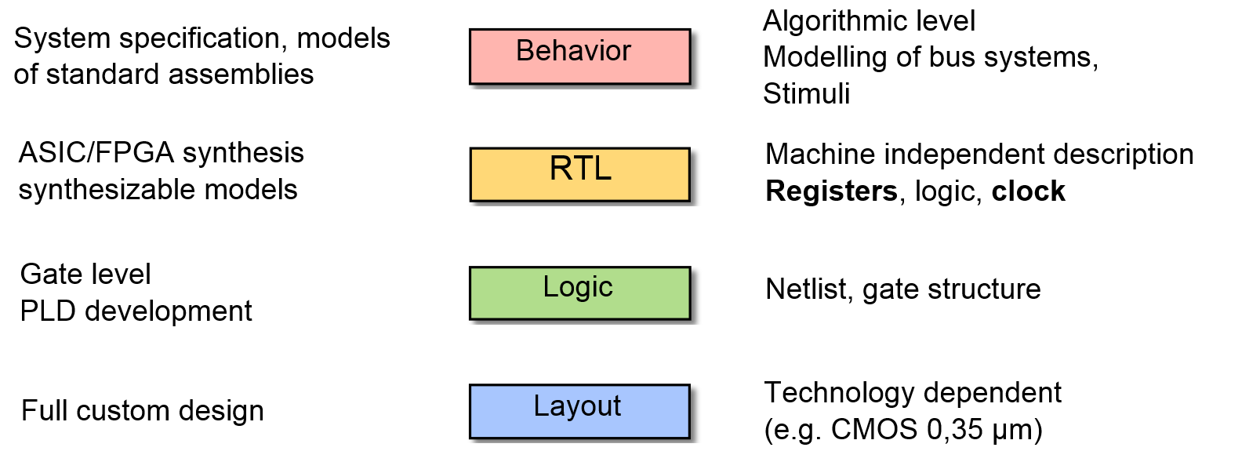
VHDL: Abstraction Levels (II)
HDL — <number>

Slide 22
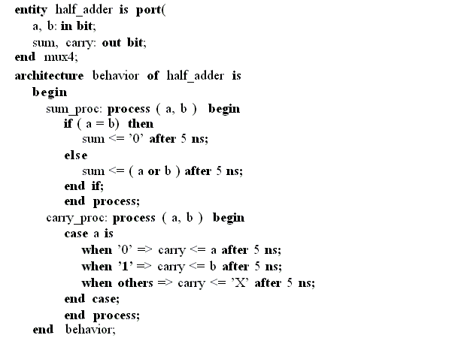
Behavioral Description in VHDL
This level describes a system by concurrent algorithms (Behavioral).
Each algorithm itself is sequential (consists of a set of instructions that are executed one after the other.)
Functions, procedures are the main elements. There is no regard to the structural realization of the design.
We describe the behavior of an entity using sequential statements
It very similar to high-level programming languages in syntax and semantics
Writing a program in behavioral style is by using something called a “process”.
Such descriptions are usually simulatable, but not synthesizable.
HDL — <number>

Slide 23
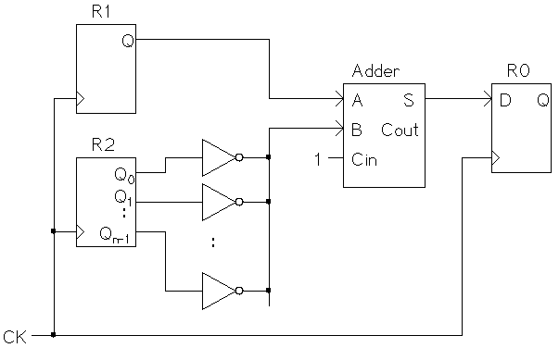
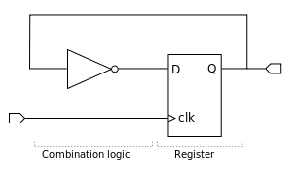
RT Level in VHDL (Data flow)
RTL: Register Transfer Level
Specifying the characteristics of a circuit by how data is transformed as it is passed from register to register.
The transforming of the data is performed by the combinational logic that exists between the registers.
The description is divided into combinational logic and storage elements. The storage elements (flip-flops, latches) are controlled by a system clock.
Modern definition of a RTL code is "Any code that is synthesizable is called RTL code".
The description is synthesizable.
HDL — <number>

Slide 24
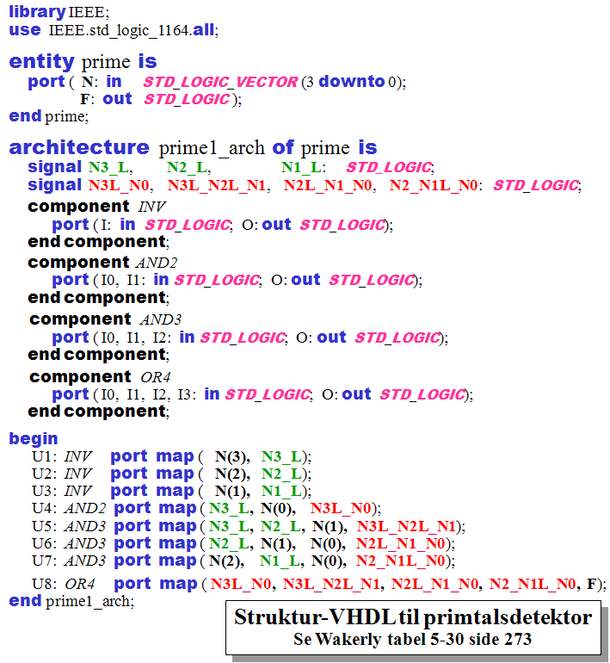
Gate-level in VHDL (Structural)
The description has been synthesized.
A gate level description consists of a network of gates and registers instanced from a technology library
The interconnection of components within an architecture.
It is called netlisting language
The design is represented as a netlist with gates (AND, OR, NOT,...) and storage elements, all with cell delays.
HDL — <number>
Notes:
The University of Adelaide, School of Computer Science
Chapter 2 — Instructions: Language of the Computer

Slide 25
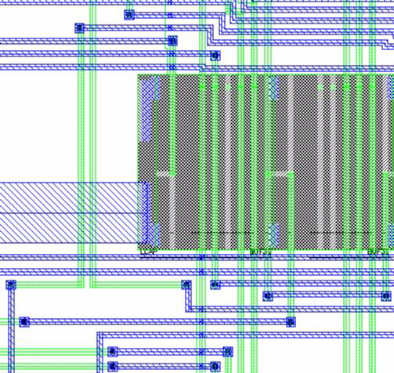
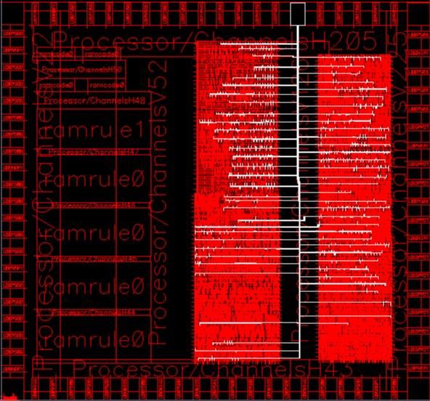
Layout Level Description
The different cells of the target technology are placed on the chip and the connections are routed.
After the layout has been verified, the circuit is ready for the production process.
If the layout is completed, the wire lengths and thus the propagation delays due to parasitic will be known. The design can be simulated on gate level netlist added with propagation delays, after back-annotation, and, consequently, the timing behavior of the entire circuit can be validated.
Back Annotation: Taking the delays from the layout (after place&route phase) and entering them into the description (schematic or HDL-based), this way allowing to do more realistic simulation.
HDL — <number>

Slide 26
Let’s start VHDL
HDL — <number>

Slide 27
Let’s Start Simple
The structure of a Full Adder
In1
s1
sum
In2
s2
s3
c_out
c_in
HDL — <number>

Slide 28
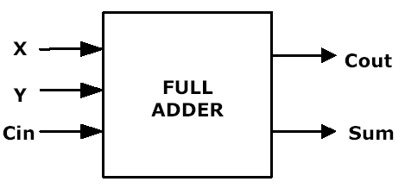
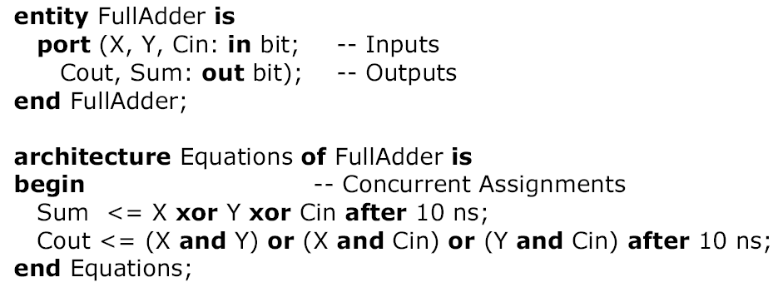
Entity-Architecture Pair
1- in
2- out
3- inout
4- buffer
entity name
port names
port mode (direction)
port type
punctuation
reserved words

Slide 29
Entity Declarations
The entity describes the interface to the outside world.
It specifies the number of ports, the direction of the ports, and the type of the ports
The interface signals are listed in the PORT clause
  In this respect, the entity is akin to the schematic symbol for the component
Entity is roughly equivalent to a function definition in C
Notes:
25

Slide 30
Entity Example
x
cout
y
FULL
Adder
sum
cin
ENTITY full_adder IS
PORT( x, y, cin : IN BIT;
cout, sum : OUT BIT);
END full_adder;

Slide 31
Entity Declarations
Port Clause
Three parts of the PORT clause
  Name
  Mode
  Data type
PORT (signal_name : mode data_type);
PORT ( input : IN BIT_VECTOR(3 DOWNTO 0);
ready, output : OUT BIT );
Notes:
26

Slide 32
Entity Declarations
The Port Mode of the interface describes the direction in which data travels with respect to the Component
Four Port Modes
  In (Input port): A variable or a signal can read a value from a port of mode in, but is not allowed to assign a value to it.
  Out (Output port): It is allowed to make signal assignments to a port of the mode out, but it is not legal to read from it.
  Inout (bidirectional port): Both assignments to such a port and reading from it are allowed.
  Buffer: output port with read capability. It differs from inout in that it can be updated by at most one source, whereas inout can be updated by zero or more sources.
Notes:
27

Slide 33
About Buffer port mode
VHDL allows buffer port mode when a signal is used both internally, and as an output port when there is only one internal driver.
Buffer ports are a potential source of errors during synthesis, and complicate validation of post-synthesis results through simulation.
RECOMMENDED: Do not use buffer port mode!
HDL — <number>

Slide 34
Entity: Example
8
inputs
3
Mux8to1
output
Select_s
entity Mux8to1 is
port (
Inputs : in Std_Logic_Vector(7 downto 0);
Select_s : in Std_Logic_Vector(2 downto 0);
Output : out Std_Logic
);
end Mux8to1;
HDL — <number>

Slide 35
Architecture Body
Describes the operation of the component, Not just its interface
It describes the underlying functionality of the entity and contains the statements that model the behavior of the entity.
More than one architecture can (and usually) is associated with each entity
Each architecture suited to different type of modeling
  E.g., a behavioral arch., a structural arch, a RTL arch.
Notes:
29

Slide 36
Architecture Body (II)
Consists of Two Parts
  1. Declarative part -- includes necessary declarations, e.g.
    Type declarations
    Signal declarations
    Component declarations
    Subprogram declarations
  2. Statement part -- includes statements that describe organization and/or functional operation of component, e.g.
    Concurrent signal assignment statements
    Process statements
    Component instantiation statements

Slide 37
Architecture Body, e.g.
The architecture name
ARCHITECTURE structural OF full_adder IS
-- architecture declarative part
SIGNAL xor_res : BIT ;
-- architecture statement part
BEGIN
cout <= (x AND y) OR (x AND cin) OR (y AND cin) ;
xor_res <= x XOR y ;
sum <= xor_res XOR cin;
END structural ;
Declarative Part
Statement Part
The Entity name
End of architecture

Slide 38
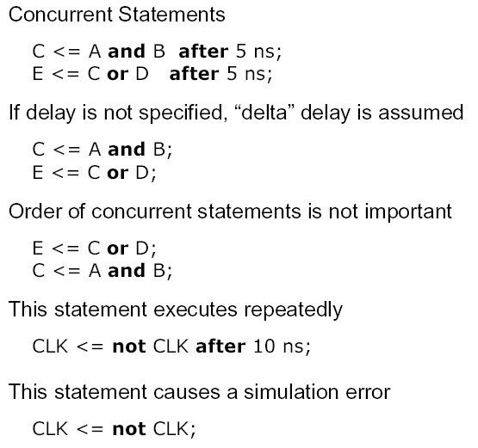
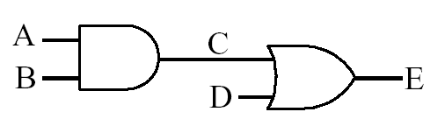
VHDL Description of Combinational Networks

Slide 39
Lexical Elements of VHDL
Comments
  two dashes to end of line is a comment, e.g.,
  --this is a comment
Basic Identifiers
  Can Only Use
    alphabetic letters ( A-Z, a-z ), or
    Decimal digits ( 0-9 ), or
    Underline character ( _ )
  Not case sensitive
  ( LastValue = = lAsTvALue)
Reserved Words
  Do not use as identifiers
Special Symbols
  Single characters
& ‘ ( ) * + , - . / : ; < = > |
  Double characters (no intervening space)
=> ** := /= >= <= <>
Copyright © 1997, KJH

Slide 40
Identifiers
Identifiers are used to name items in a VHDL model
may only contain alphabetic letters (‘A’ to ‘Z’ and ‘a’ to ‘z’), decimal digits (‘0’ to ‘9’) and the underline character (‘_’);
must start with an alphabetic letter;
may not end with an underline character; and
may not include two successive underline characters.

Slide 41
Examples of identifiers
Some examples of valid basic identifiers are
  A
  X0
  counter
  Next_Value
  generate_read_cycle
Some examples of invalid basic identifiers are
  last@value
  5bit_counter
  _A0
  A0_
  clock__pulse
  –– contains an illegal character for an identifier
–– starts with a nonalphabetic character
–– starts with an underline
–– ends with an underline
–– two successive underlines

Slide 42
Reserved Words
we cannot use reserved words as identifiers for items we define
Reserved words in VHDL
abs access after alias all and architecture array assert attribute begin block body buffer bus case component configuration constant | disconnect downto else elsif end entity exit file for function generate generic group guarded if impure in inertial inout | is label library linkage literal loop map mod nand new next nor not null of on open or others | out package port postponed procedure process pure range record register reject return rol ror select severity signal shared sla | sli sra srl subtype then to transport type unaffected units until use variable wait when while with xnor xor

Slide 43
Strings
Bit Strings
  B for binary ( b”0100_1001” )
  O for Octal ( o”76443” )
  X for hexadecimal ( x”FFFE_F138” )

